Slide 1

Juventus Predictive analysis of stocks. Exploring Trends, Volatility, and Sentiment for Investment Insights
Udrea Radu-Cristian
Branescu Bianca-Andreea

Slide 2
Abstract
Objective: Analyze Juventus stock performance using Python-based statistical and sentiment analysis.
Methods: Stock data analysis, Beta calculation, volatility tracking, and sentiment analysis of Andrea Agnelli’s final speech.
Goal: Provide investors with insights into Juventus’s stock behavior and investment potential.

Slide 3

Introduction
Juventus is both a football club and a publicly traded company (Ticker: JUVE.MI).
Stock performance is influenced by match results, financial news, and market trends.
The study combines quantitative (stock trends, volatility) and qualitative (sentiment analysis) methods.

Slide 4

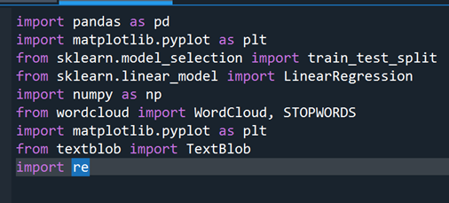
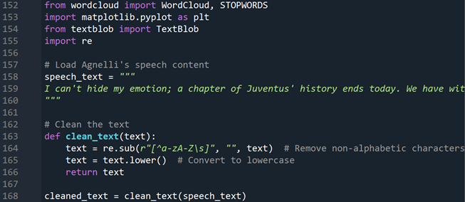
Methodology
Data Collection: Monthly stock data from Investing.com.
Data Cleaning: Adjusted date formats, standardized values, calculated returns & volatility.
Analysis Tools: Python libraries for statistical modeling & sentiment analysis.

Slide 5
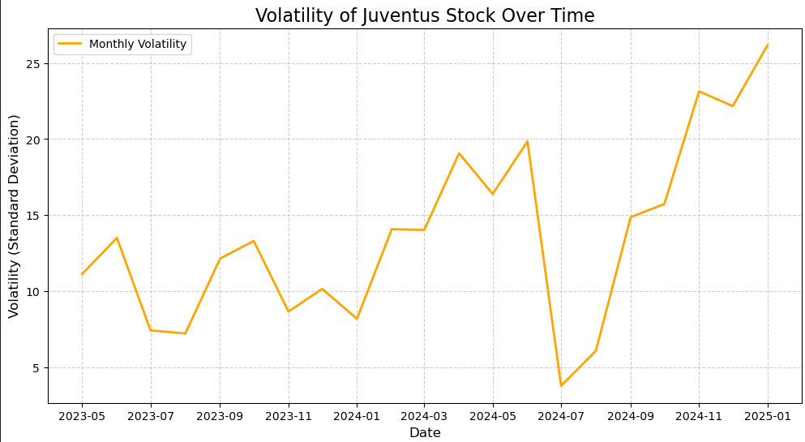
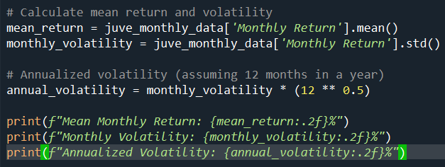
Volatility Analysis
Volatility is key for assessing investment risk.
Juventus’s monthly volatility: 13.80%, annualized at 47.82%.
High volatility presents both investment opportunities and risks.

Slide 6
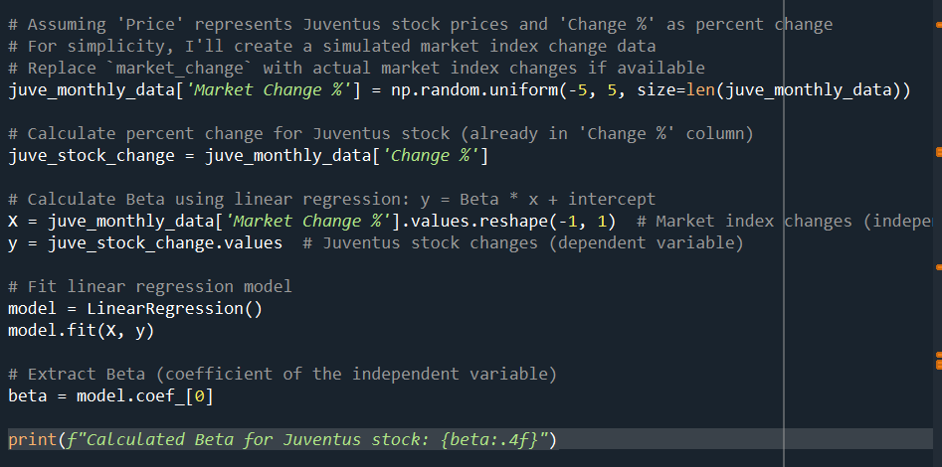
Beta Calculation & Market Sensitivity
Beta measures stock sensitivity to market changes.
Juventus’s Beta = -0.8389, meaning it moves opposite to market trends.
This suggests Juventus’s stock is more influenced by club events than broader market trends.

Slide 7
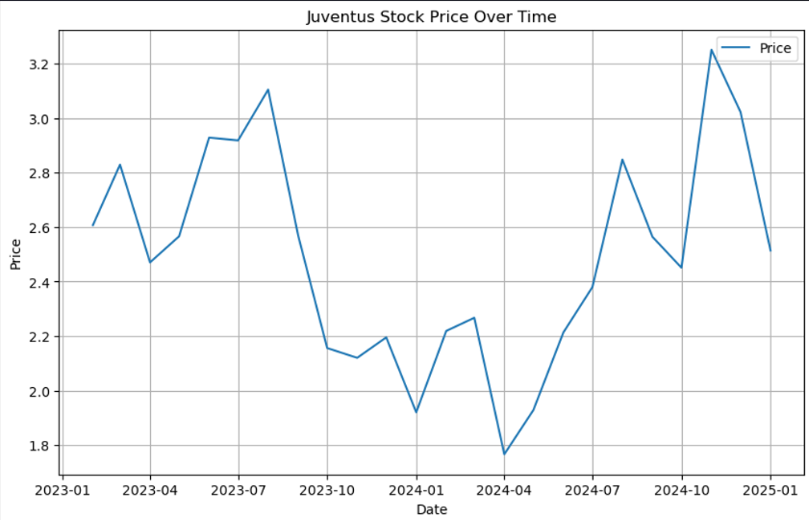
Juventus Stock Price Trends (Graph)
Early 2023: Gradual price increase, possibly due to positive sentiment.
Mid-2023 to Late-2023: Sharp decline (~3.2 to ~2.0), indicating financial instability or bad match results.
2024: Highly volatile, reacting to sporting events & financial updates.

Slide 8
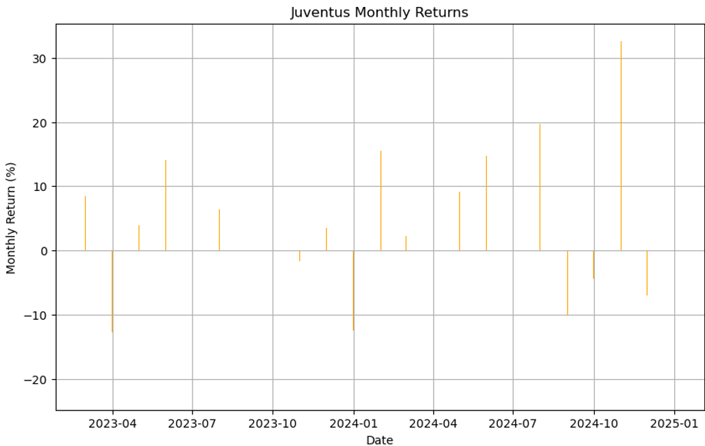
Monthly Returns Analysis (Graph)
Positive returns in mid-2023 & late 2024 (+30%), likely due to strong club performance.
Negative returns (-20%) in late 2023 & mid-2024, reflecting financial concerns or poor match results.
High variability suggests stock is highly reactive to external factors.

Slide 9
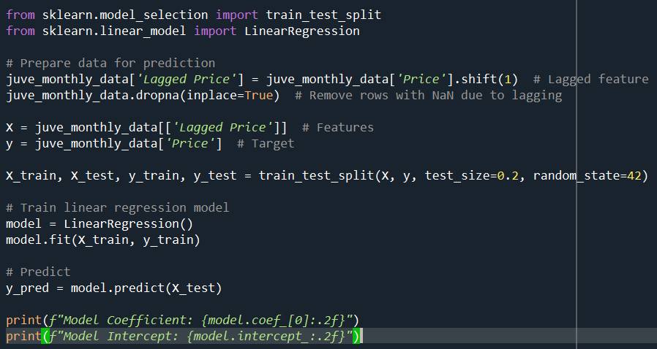
Predictive Modeling (Linear Regression)
Model Coefficient = 0.64 → Stock price follows previous month’s trend but not perfectly.
Intercept = 0.85 → The baseline stock price when past data is excluded.
Implication: Juventus stock price depends on past values but is also affected by other factors.

Slide 10

Sentiment Analysis of Agnelli’s Speech
Objective: Analyze the speech to assess investor sentiment.
Method: Text cleaning, word frequency analysis, & sentiment scoring.
Key Themes: "European football," "UEFA," "ECA," "structural changes" → Indicates concerns about governance & club strategies.
Polarity: Slightly positive (+0.12), showing a hopeful outlook despite challenges.
Subjectivity: Moderately high (0.46), meaning the speech contains opinions & reflections rather than pure facts.
Implication for Investors: Confidence in Juventus’s long-term strategic plans, despite short-term uncertainties.

Slide 11

Discussion & Investment Recommendations
High volatility → Requires active monitoring of financial & match results.
Negative Beta → Good for portfolio diversification, as it moves differently than the market.
Moderate returns (0.74% per month) → Suitable for investors willing to take risks.

Slide 12

Conclusion
Juventus stock is highly reactive to club-specific events rather than market trends.
Sentiment analysis shows that leadership acknowledges challenges but remains optimistic.
Investors should approach Juventus stock with a strategic mindset, focusing on key club developments.

